Slide 1




KICK OFF MEETING
วันอังคารที่ 11 กันยายน 2561 งานจ้างเหมาโครงการพัฒนาระบบไฟฟ้าแบบเครือข่ายไฟฟ้า ขนาดเล็กมาก (Micro Grid)
ที่อ าเภอแม่สะเรียง จังหวัดแม่ฮ่องสอน (คพล.)
สัญญาเลขที่ จ. 82/2561
การไฟฟ้าส่วนภูมิภาค

Slide 2

MEETING AGENDA
Project Detail
Scope of work
Project Management & Project Timeline
Procurement support detail and lead time of delivery
Financial & Accounting support

Slide 3

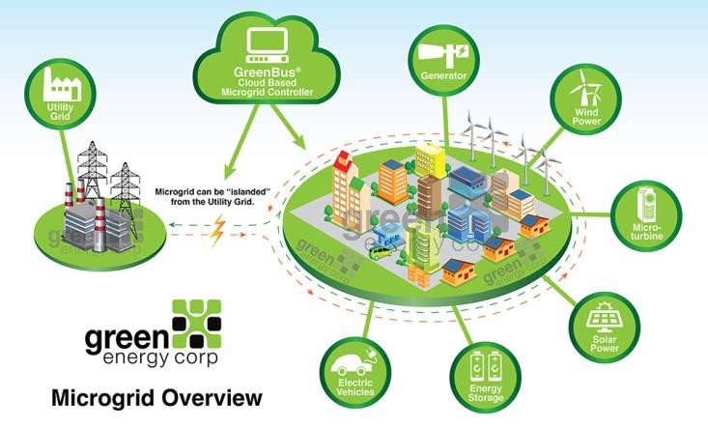
Project Detail
Microgrid Maesariang PEA Project Project Information
Project Owner: PEA
Location:
MAESARIANG MAE HONG SON Province Thailand
Scope : EPC
Gunkul Power Development Co., Ltd. NR Electric Co., Ltd (CHINA)
❐
Budget: 132,900,000 THB Incld.VAT
Lead Time Delivery: 360 Days
Sign contract: about: 7 SEP 2018
End of Contract: SEP 2019
❐
❐

Slide 4
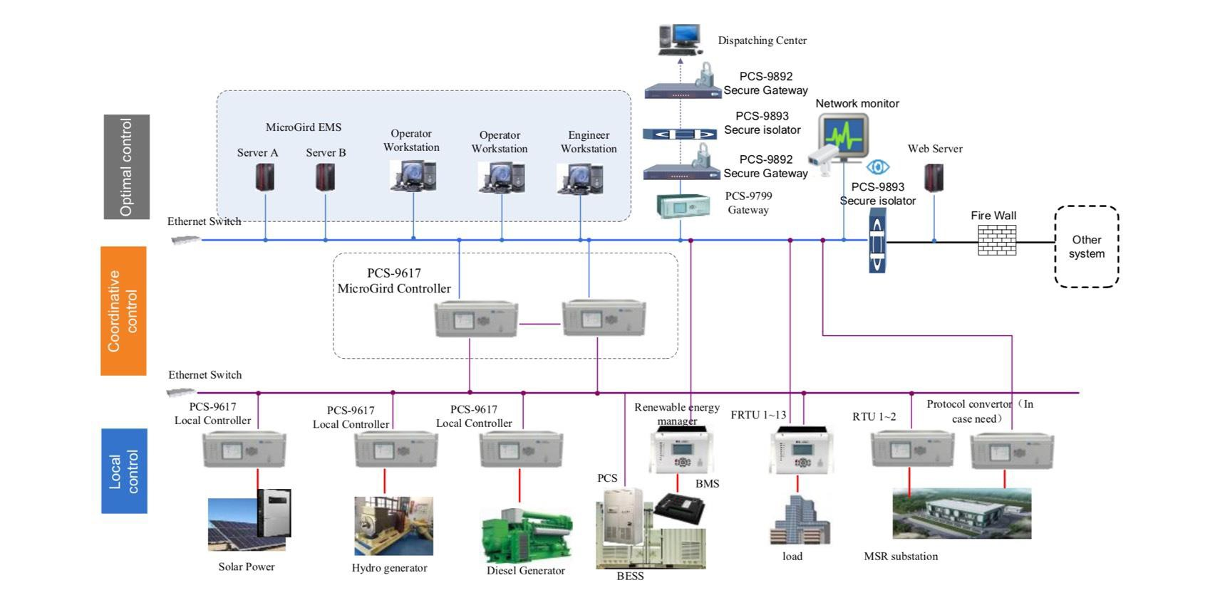
Project Detail
Microgrid Maesariang PEA Project Project Information

Slide 5
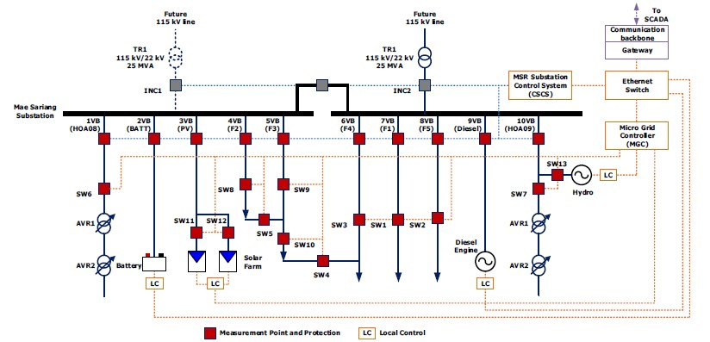
Project Detail
Microgrid Maesariang PEA Project Project Information
4

Slide 6
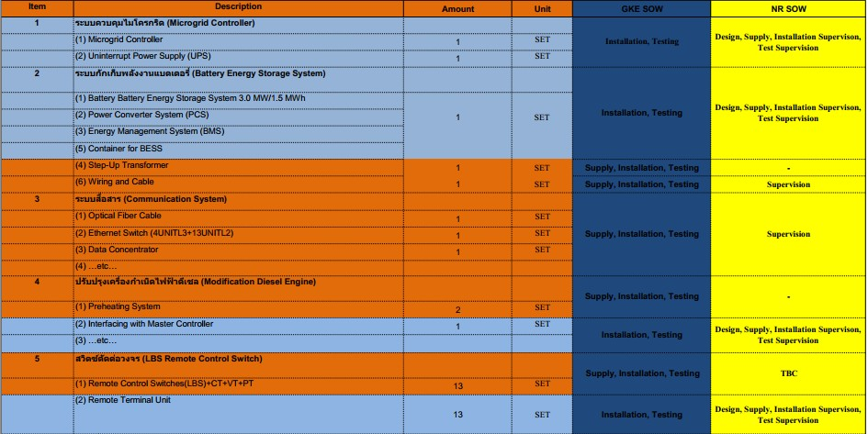
Scope Of Work
Microgrid Maesariang PEA Project Project Information
5

Slide 7
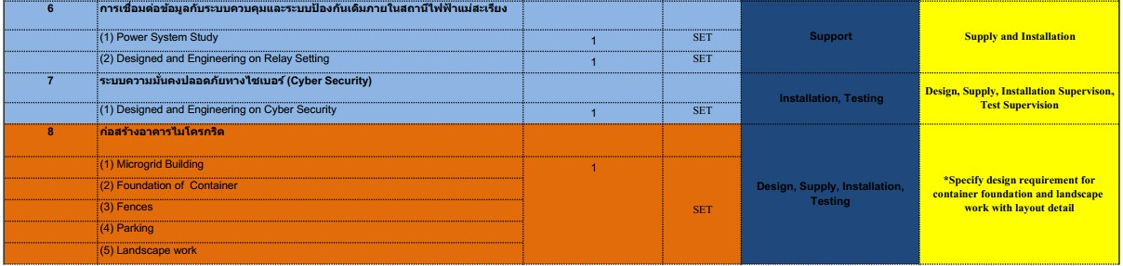
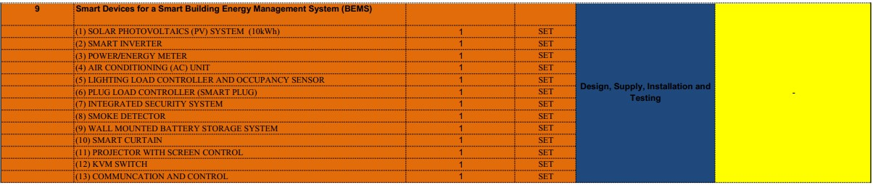
Scope Of Work
Microgrid Maesariang PEA Project Project Information
6

Slide 8
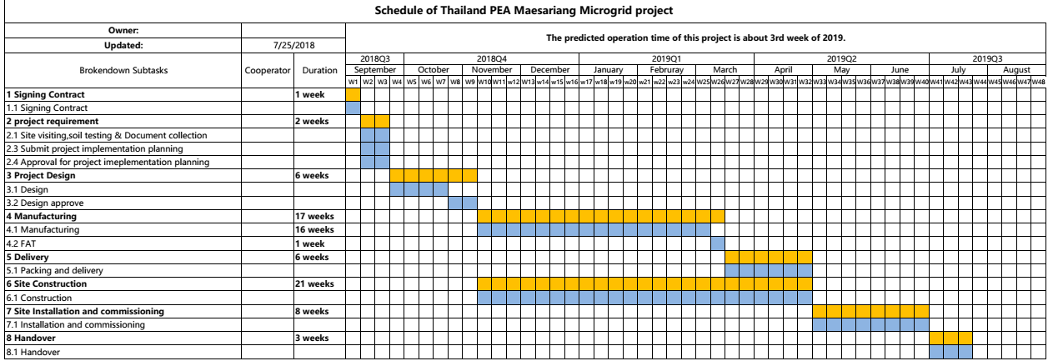
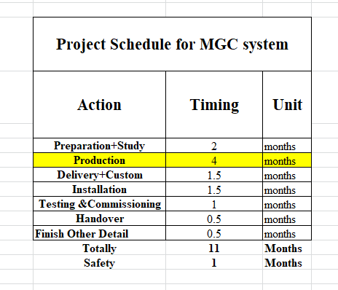
Project Management & Project Timeline

Slide 9
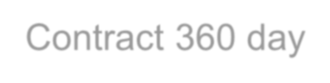
















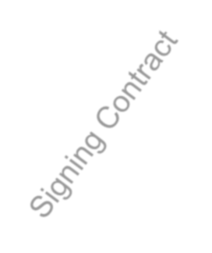






























































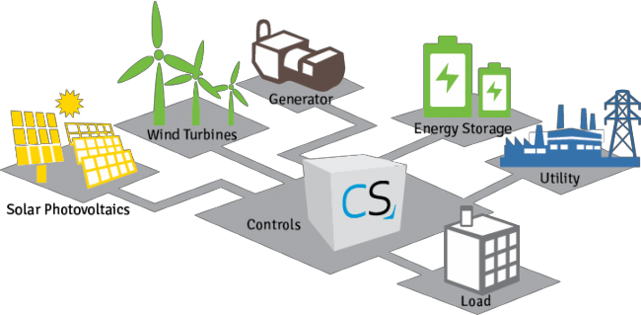
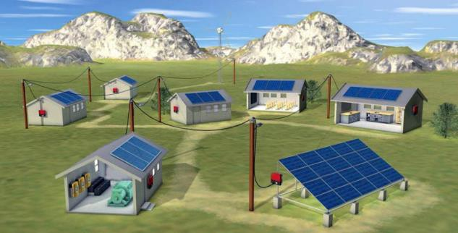
Project Management & Project Timeline
Maesariang Microgrid project : Contract 360 day
315 Days
1 week
1 week
8 week
17 week
1 week
5 week
8 week
3 week
Hand Over
nd
12 Sept 18
(Nov18- April19)
(15th Mar 19)
(May-June19)
11st Sept 18
7th sept 18
(17th Sept18)
(17th Nov 18)
(Nov18-Mar19)
(Mar 19- Apr19)
(July19)
(AUG 19)

Slide 10
Project Management & Project Timeline
Microgrid Maesariang PEA Project Organization Chart
PEA
Project Director
Mr. Chaiyaporn K.
Asst. Project Director
Mr. Bancha Y. Asst. Project Manager
Mr. Niwat P. Mr. Tinnawat C.
Purchasing Support
( )
Project Manager
Mr. Krit C.
Engineering Manager
Mr. Jessada P.
Construction Manager
Mr. Rawat S.
NR Electric
Mr. Peter Z.
Civil Work
Mr. Rawat S.
Electrical Work
Mr. Panya K.
Electrical Designer
( )
Civil Designer
( )
Civil Subcontractor
( )
Electrical Subcontractor
( )
NR Electric
(Erection & Comm. Team )
9

Slide 11
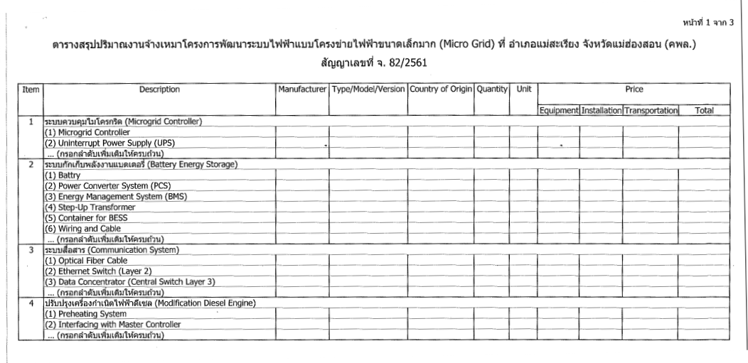
Procurement Detail Support
Microgrid Maesariang PEA Project
Equipment List

Slide 12
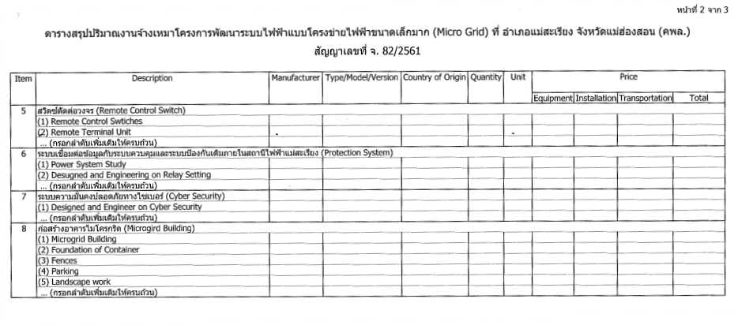
Procurement Detail Support
Microgrid Maesariang PEA Project
Equipment List

Slide 13
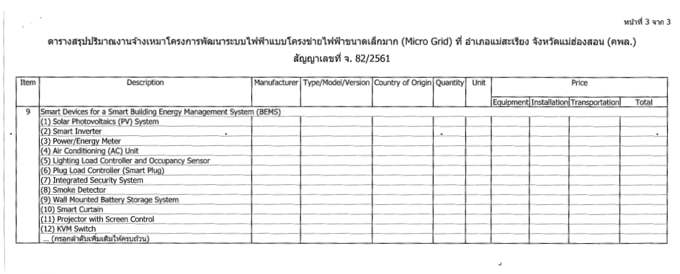
Procurement Detail Support
Microgrid Maesariang PEA Project
Equipment List
12

Slide 14
Financial & Accounting Support
Microgrid Maesariang PEA Project

Slide 15

Financial & Accounting Support
Microgrid Maesariang PEA Project
BG Support
Performance Bond for Advance payment 10% (AUG2018)
Project warranty bond 10% (SEP2019) 3 years warranty
Payment Term
1.Receive Advance Payment 10%
10% Payment = 13,290,000THB (Sep 2018)
2.Receive Payment 10% (After system study)
10% Payment = 13,290,000THB (Nov 2018)
3.Receive Payment 20% (After FAT)
20% Payment = 26,580,000THB (Apr 2019)
4.Receive Payment 30% (After Installation)
30% Payment = 39,870,000THB (Jun 2019)
5.Receive Payment 20% (After Site Acceptance Test)
20% Payment = 26,580,000THB (July 2019)
6.Receive Last Payment 10% (After system study)
10% Payment = 13,290,000THB (Aug 2019)

Slide 16
Gunkul Engineering Public Company Limited
1177 Pearl Bangkok Building, 8th Floor, Phahonyothin Road, Phayathai , Phayathai, Bangkok 10400
15

